Slide 1
Trigger Efficiency Analysis in the ICARUS Neutrino Detector
Tanvi Krishnan
Mentor: Gianluca Petrillo
Stanford Linear Accelerator Center
Notes:
I’m Tanvi Krishnan, I’m a SULI intern at the Stanford Linear Accelerator Center this summer working on analyzing the efficiency of the trigger system in the ICARUS neutrino detector. I’ll explain my work this summer to answer one overarching question, which is

Slide 2



How can efficiency analyses help improve the performance of experimental systems?
What is a neutrino?
Detector & Trigger overview
Efficiency Analysis
Notes:
How can efficiency analyses benefit your experimental systems? I’ll first explain what a neutrino is, then explain how the ICARUS neutrino detector and its trigger system work, and finally talk about efficiency analyses and how they are used in the ICARUS experiment.

Slide 3
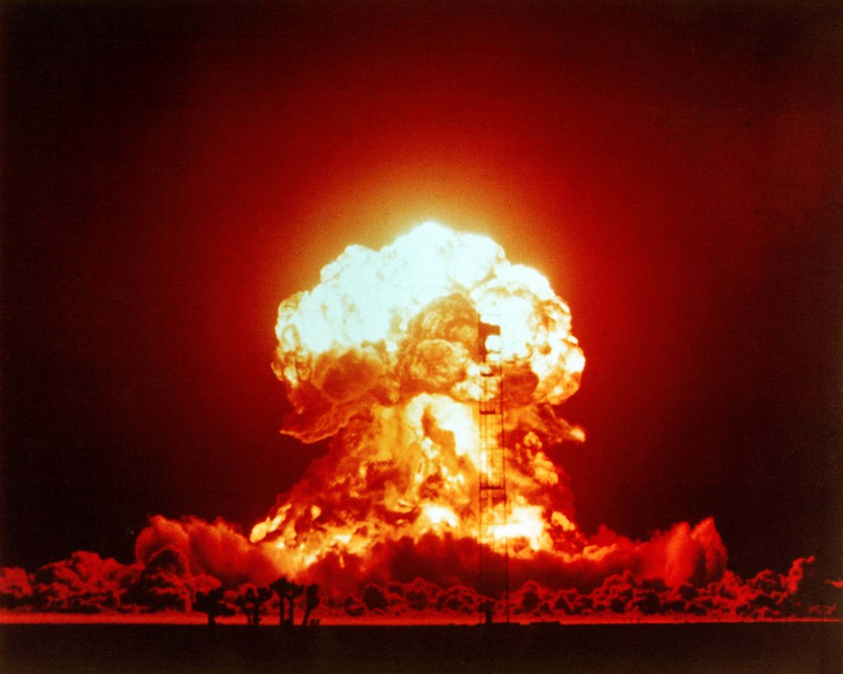
Why study Neutrinos?
Notes:
Neutrinos have many potential applications – including detecting the production of illicit nuclear weapons before they are deployed. (PAUSE) However, before we can use neutrinos like this, we need to have a solid understanding of their properties, and detectors like ICARUS are helping us learn more.

Slide 4

What is a Neutrino?
Sandbox Studio, Chicago with Ana Kova. “Scientists Study Neutrinos Produced by Nuclear Reactors, Radioactive Decay, Particle Accelerators, the Sun, the Earth, and the Cosmos.” SciTechDaily, 2020, https://scitechdaily.com/science-made-simple-what-are-neutrinos/. Accessed 2022.
Notes:
So, what is a neutrino? Neutrinos are extremely small, neutrally charged, nearly massless elementary particles that are formed as a byproduct of nuclear reactions. This makes them very hard to detect directly, but we can still learn about them by studying the particles they turn into, such as muons.

Slide 5
ICARUS Detector (Imaging Cosmic And Rare Underground Signals)
Detector
Ar
e⁻
light
Ar
µ
muon
Notes:
The ICARUS neutrino detector, which is located at Fermilab, is made up of two chambers like the one shown, both filled with liquid Argon. A neutrino passing through the detector might turn into a muon which causes Argon atoms to emit light or kick out electrons as it passes.

Slide 6
ICARUS Detector (Imaging Cosmic And Rare Underground Signals)
Detector
e⁻
light
e⁻
e⁻
light
e⁻
e⁻
light
e⁻
e⁻
light
e⁻
µ
muon
Notes:
Although we can’t directly “see” the particle, we can reconstruct its track by analyzing the trail it leaves behind. And this would work well, except other subatomic particles that we aren’t currently studying also pass through the detector and leave similar tracks.

Slide 7
light
e⁻
e⁻
e⁻
e⁻
e⁻
light
light
e⁻
e⁻
e⁻
light
e⁻
e⁻
light
light
Filter
e⁻
e⁻
light
e⁻
e⁻
e⁻
light
µ
muon
Notes:
As you can probably imagine, we would accumulate massive amounts of data if we recorded every single particle interaction in the detector, and many of the tracks would be from particles we aren’t studying. We call this the background, and we need some way to filter these out.

Slide 8
Trigger Logic
Light > Threshold
True
False
Record
Ignore
Notes:
The trigger system is sort of our first line of defense in filtering the background. It works by setting a certain threshold of light that must be seen by the detector at a time to cause us to record the event.

Slide 9





Analogy: Detective Movie
Crime Scene
criminal
Notes:
You can think of this like your favorite detective movie. The muons are the criminals, and the detector is the crime scene. We first filter out the clues from everything else found at the crime scene, then reconstructs the clues to uncover the criminal’s plan.

Slide 10


Analogy: Detective Movie
Crime Scene
❓
❓
❓
criminal
❓
Notes:
If the filtration step didn’t exist or didn’t work efficiently, then the detective might get confused and not be able to figure out the criminal’s plan, and if they have lots of cases to solve, they may not be able to catch all the criminals.

Slide 11
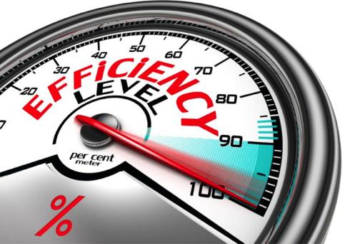
Notes:
The efficiency of the trigger system in ICARUS is also very important, as we don’t want to cause problems with exceeding our “data budget” and with reconstructing the particle tracks in further steps of analysis, so my work this summer has been to analyze the efficiency of the trigger system.

Slide 12
Trigger Emulation
Level 1: 1 sensor detects light
Level 2: 3 sensors detect light
Level 3: 5 sensors detect light
Level 4: 10 sensors detect light
Notes:
Now, we want to test out different thresholds for the trigger system, so we collect a run where everything, including background, was recorded and processed. We then use software to emulate different trigger thresholds to predict which tracks would cause each level of trigger to fire.

Slide 13

Trigger Emulation
Level 3: 5 sensors detect light
Maximize Efficiency
Minimize Background
Notes:
And using this information we can determine the trigger threshold that maximizes the efficiency of recording our desired tracks while minimizing the background we accumulate. The level 3 trigger is actually the threshold that’s currently employed in the detector, based on prior analysis.

Slide 14

Efficiency Plots
efficiency
track length
Notes:
We can also look at the efficiency of the trigger as a function of different variables, like the length of the track, to determine how confident we are in the results of our experiment for different regions of parameter-space. For example,

Slide 15
Notes:
in this plot, we see that the trigger is more efficient for longer tracks. So, when studying longer tracks we can be more confident that we have recorded almost all the events that occur in the detector.

Slide 16




How does this help?
Increase Efficiency
Increase Confidence in Results
Collect More Useful Data
Learn How Neutrinos Work
Notes:
So, what do we do with all this information? We can modify the trigger threshold to increase efficiency, allowing us to collect more useful data and increase statistical confidence in our results. Then we can learn more about how neutrinos work

Slide 17


Make Use of Neutrinos
Notes:
Which puts us well on our way to making use of neutrinos, such as by employing them to detect the production of illicit nuclear weapons, which could prevent nuclear proliferation and terrorism.

Slide 18
Recap
What is a neutrino?
Detector & Trigger Overview
Efficiency Analysis
Notes:
In summary, I first explained what a neutrino is, then described how the ICARUS neutrino detector and its trigger system work, and finally talked about efficiency analysis and how they played a role in my research.

Slide 19



Efficiency Analysis
Notes:
Just as I am using efficiency analyses to improve the performance of the ICARUS trigger system, I hope you can implement efficiency analyses of your own experimental systems using the basic ideas I’ve laid out here.

Slide 20

Efficiency Analysis
❓
criminal
Notes:
Remember that even in a system as complex as a neutrino detector, data collection and processing is just like a detective movie and efficiency analyses can help you solve more cases in less time! Thank you for listening.

